Slide 1




Introduction to .NET Core and EF Core
.NET Core, Entity Framework Core
Introduction to .NET Core and EF Core
SoftUni Team
Technical Trainers
Software University
http://softuni.bg

Slide 2
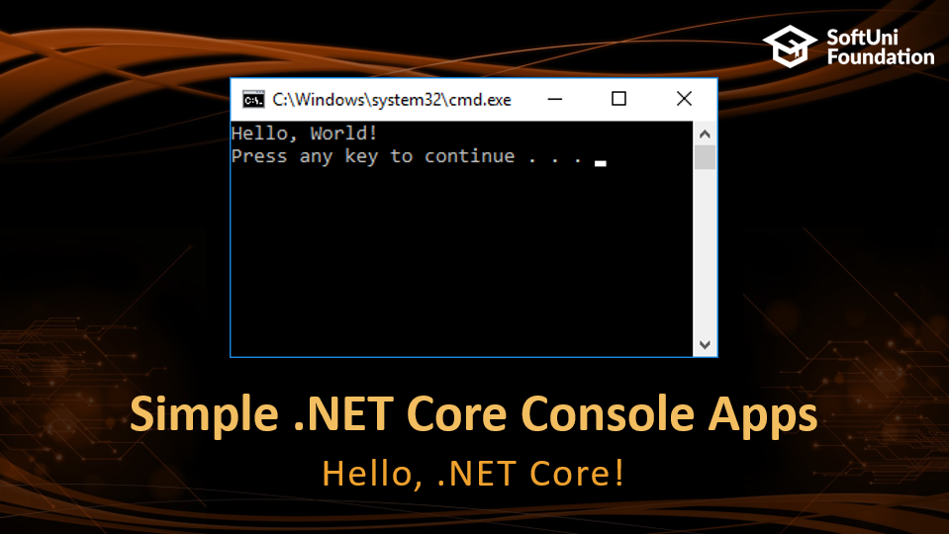

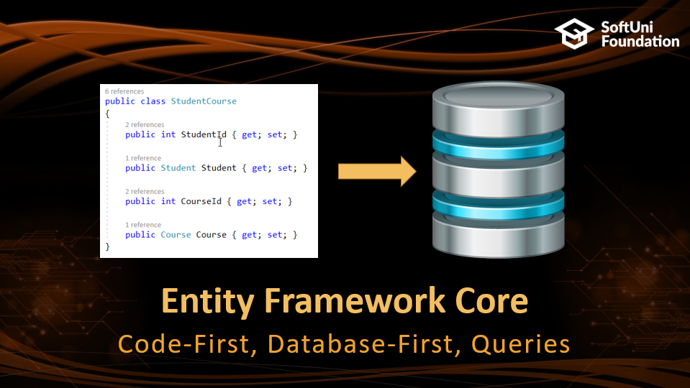
Table of Contents

Slide 3
Have a Question?
sli.do #CSharp-Web

Slide 4




.NET Core Platform
iOS
Something New, Something Old

Slide 5
.NET Core Platform
Cross-platform
.NET Core apps that run on Windows, Linux and macOS
Flexible
Each component is a package
Metapackages combine packages that are meaningful together
Lightweight
Projects include only required dependencies
Fully open-source at GitHub

Slide 6
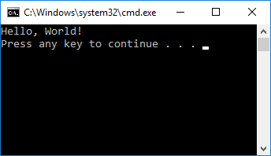
Simple .NET Core Console Apps
Hello, .NET Core!

Slide 7
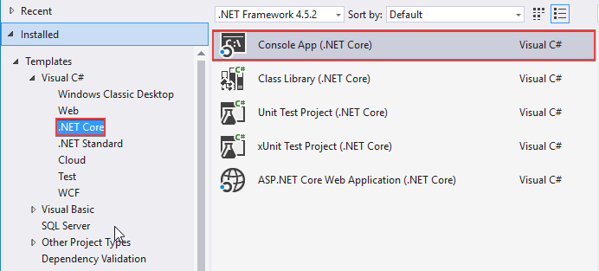
Creating console application

Slide 8
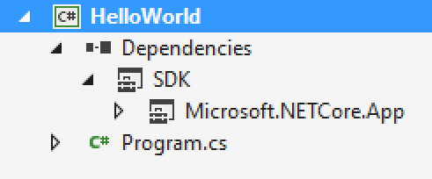
Project Structure
.NET Core project
Project Dependencies
Standard .NET Core Development Kit
.NET Core Libraries (CoreFX)
Standard C# class files

Slide 9
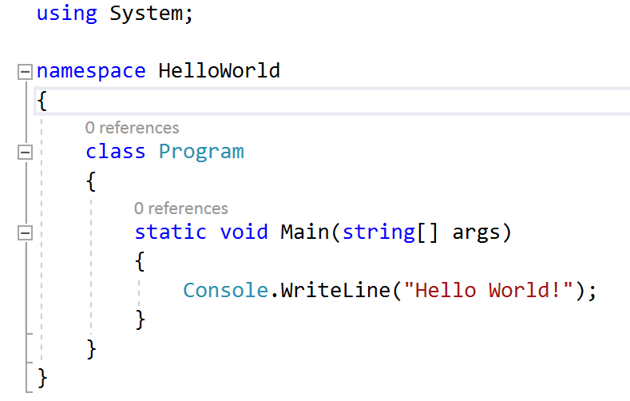
Hello World Code
.NET Core
.NET Framework

Slide 10
Problem: School Competition
You are given a sequence of students with their results
Read and aggregate data for each student
For each student print total result and a list of unique categories
Ani Math 80
Gosho Math 10
Pesho History 100
Gosho Geography 90
END
Gosho: 100 [Geography, Math]
Pesho: 100 [History]
Ani: 80 [Math]

Slide 11
Solution: School Competition
Create collections to store data and read the input
var categories = new Dictionary<string, List<string>>();
var results = new Dictionary<string, int>();
// TODO: Read and parse data
var orderedResults = results
.OrderByDescending(p => p.Value)
.ThenBy(p => p.Key);
// TODO: Print Result
System.Collections.Generic
System.Collections.Linq

Slide 12
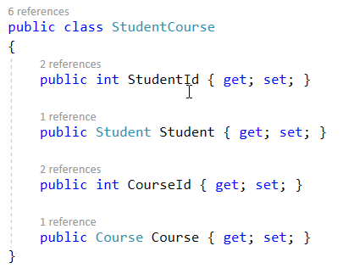

Entity Framework Core
Code-First, Database-First, Queries

Slide 13
EF Core Vs. EF 6
Lightweight, extensive and cross-platform version of EF 6
Supports non-relational databases
Features not implemented in EF Core
Many-to-many relationships without join model
VisualStudio wizard for reverse engineer model
Lazy-loading
Seed method
Automatic migrations

Slide 14
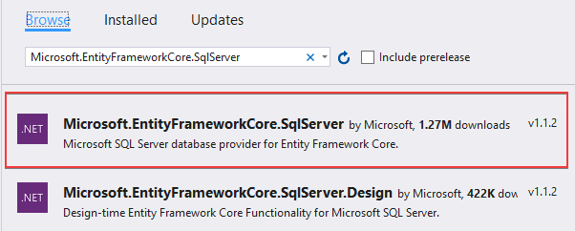
Adding EF Core to Project
With Package Manager Console
From NuGet Package Manager
Install-Package Microsoft.EntityFrameworkCore.SqlServer

Slide 15
Code-First Model – Creating the Context
Create entity model – Person with Id and Name
Create class extending DbContext
public class AppDbContext : DbContext
{
public DbSet<Person> People { get; set; }
protected override void OnConfiguring(
DbContextOptionsBuilder optionsBuilder)
{
optionsBuilder.UseSqlServer(
@"Server=.;Database=TestDb;Integrated Security=True;");
}
}
Connection string for the database

Slide 16
Code-First Model – Creating the Database
Without migrations with source code
With migrations from Package Manager Console
AppDbContext context = new AppDbContext();
context.Database.EnsureCreated();
Install-Package Microsoft.EntityFrameworkCore.Tools
Add-Migration InitialCreate
Update-Database

Slide 17
Problem: One-to-Many Relation
Implement one-to-many relation with the following entities:
Employee
Department
Employee
Employee

Slide 18
Solution: One-to-Many Relation (1)
public class Employee
{
public int Id { get; set; }
[Required]
[MaxLength(50)]
public string Name { get; set; }
public int DepartmentId { get; set; }
public virtual Department Department { get; set; }
}

Slide 19
Solution: One-to-Many Relation (2)
public class Department
{
//TODO: Initialize Employees collection
public int Id { get; set; }
[Required]
[MaxLength(50)]
public string Name { get; set; }
public virtual ICollection<Employee> Employees { get; set; }
}

Slide 20
Alternative Solution: modelBuilder object
protected override void OnModelCreating(
ModelBuilder modelBuilder)
{
modelBuilder.Entity<Employee>()
.HasOne<Department>(emp => emp.Department)
.WithMany(d => d.Employees)
.HasForeignKey(emp => emp.DepartmentId);
}

Slide 21
Problem: Self-Referenced Table
Use the database from the previous problem
Add a manager to the Employee class
The manager is an object of type Employee
The manager property is optional
Employee
Id
Name
Department
Manager

Slide 22
Problem: Self-Referenced Table
Use the database from the previous problem
Add a manager to the Employee class
The manager is an object of type Employee
The manager property is optional
Employee
Primary Key
Id
Name
Department
Foreign Key
Manager

Slide 23
Solution: Self-Referenced Table
Add property Manager and an employees collection
Implement self-reference in the OnModelCreating method
public virtual Employee Manager { get; set; }
public virtual ICollection<Employee> Employees {get;set;}
modelBuilder.Entity<Employee>()
.HasOne<Employee>(emp => emp.Manager)
.WithMany(m => m.Employees)
.HasForeignKey(emp => emp.ManagerId)
.OnDelete(DeleteBehavior.Restrict);

Slide 24
Problem: Many-to-Many Relation
Implement many-to-many relation with the following entities
Student
Course
Student
Course
Student

Slide 25
Solution: Many-to-Many Relation (1)
public class Student
{
public Student()
{
this.StudentsCourses = new HashSet<StudentsCourses>();
}
public int Id { get; set; }
public string Name { get; set; }
public ICollection<StudentCourse> StudentsCourses { get; set; }
}
// TODO: Implement the Course class

Slide 26
Solution: Many-to-Many Relation (2)
public class StudentCourse
{
public int StudentId { get; set; }
public Student Student { get; set; }
public int CourseId { get; set; }
public Course Course { get; set; }
}
Join model for Student and Course models
Implements one-to-many relation with each of the joined tables

Slide 27
Solution: Many-to-Many Relation (3)
protected override void OnModelCreating(
ModelBuilder modelBuilder)
{
modelBuilder.Entity<StudentCourse>()
.HasKey(sc => new { sc.StudentId, sc.CourseId });
modelBuilder.Entity<StudentCourse>()
.HasOne<Student>(sc => sc.Student)
.WithMany(st => st.StudentsCourses)
.HasForeignKey(sc => sc.StudentId);
//TODO: add Course-StudentCourse relation
}
Composite Primary Key

Slide 28
Database-First Model - Specifics
Requires additional components
Provides control for:
Directory for generated models
Scaffolded tables and schemas
Name of generated DbContext model
Attributes to configure the model
Can be applied only to projects marked as StartUp Project
More information and examples in EF Core Documentation

Slide 29
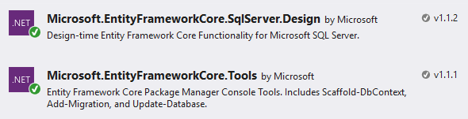
Database-First Example: Needed Packages
Install with Package Manager Console
Install-Package Microsoft.EntityFrameworkCore.Tools
Install-Package Microsoft.EntityFrameworkCore.SqlServer.Design
Install From NuGet Package Manager

Slide 30
Example: Create the Database (1)
Run the scripts to create a database and add a table
CREATE DATABASE [BlogDb];
GO
USE [BlogDb];
GO
CREATE TABLE [Users] (
[UserId] int NOT NULL IDENTITY,
[Name] nvarchar(max) NOT NULL,
CONSTRAINT [PK_User] PRIMARY KEY ([UserId])
);
GO

Slide 31
Example: Create the Database (2)
Run the script to add a table with primary and foreign keys
CREATE TABLE [Posts] (
[PostId] int NOT NULL IDENTITY,
[UserId] int NOT NULL,
[Title] nvarchar(max),
CONSTRAINT [PK_Post] PRIMARY KEY ([PostId]),
CONSTRAINT [FK_Post_User_UserId] FOREIGN KEY ([UserId])
REFERENCES [Users] ([UserId]) ON DELETE CASCADE
);
GO

Slide 32
Example: Create the Database (3)
Run the scripts to add a table
CREATE TABLE [Comments] (
[CommentId] int NOT NULL IDENTITY,
[UserId] int NOT NULL,
[PostId] int NOT NULL,
[Content] nvarchar(max),
CONSTRAINT [PK_Comment] PRIMARY KEY ([CommentId]),
CONSTRAINT [FK_Comment_User_UserId] FOREIGN KEY ([UserId])
REFERENCES [Users] ([UserId]) ON DELETE CASCADE,
CONSTRAINT [FK_Comment_Post_PostId] FOREIGN KEY ([PostId])
REFERENCES [Posts] ([PostId])
);
GO

Slide 33
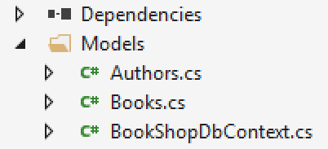
Example: Scaffold Models
Scaffold models with Package Manager Console
Scaffold-DbContext "Server=(localdb)\mssqllocaldb; Database=Blogging;Integrated Security=True;" Microsoft.EntityFrameworkCore.SqlServer
-OutputDir Models
Database provider
Namespace with scaffolded models

Slide 34
EF Core - Query Related Data
Lazy loading is not implemented in EF Core yet
With eager loading related data is loaded in the initial query
With explicit loading related data is loaded at a later time
var posts = context.Posts.Include(p => p.Comments);
var blog = context.Blogs.Single(b => b.BlogId == 1);
context.Entry(blog)
.Collection(b => b.Posts)
.Load();

Slide 35
Problem: Shop (1)
Create database for a small online shop.
Entities: Customer and Salesman
Read a line with salesman names,
Names are separated by ";"
Read a sequence of customers to register
Input comes in the format until receiving "END"
Customer
Id
Name
Salesman
Id
Name
register-<customer name>;<salesman id>
Customers

Slide 36
Problem: Shop (2)
Print all the salesmen with the number of their customers
Order the result by number of customers in descending order
Order salesmen with equal number of customers by name in ascending order
Ivan;Pesho;Andrey
register-Ani;1
register-Pavel;1
register-Gosho;2
register-Maria;3
END
Ivan - 2 customers
Andrey - 1 customers
Pesho - 1 customers

Slide 37
Solution: Shop
string[] salesmanNames = Console.ReadLine().Split(';');
// TODO: Fill salesmen names in the database
// TODO: Read customer data and fill it in the database
var salesmen = context.Salesmen
.Include(x => x.Customers)
.OrderByDescending(x => x.Customers.Count)
.ThenBy(x => x.Name);
// TODO: Print the results

Slide 38
Problem: Shop Extended (1)
Extend the database with the following models
Entities: Order, Review
Add a collection of Orders and Reviews to the Customer
Customer
+Orders
+Reviews
Order
Review
Id
Id
Customer
Author

Slide 39
Problem: Shop Extended (2)
Fill salesmen in the database
Ivan;Pesho
register-Ani;1
register-Maria;2
order-1
review-1
order-2
order-2
review-2
END
Maria
Orders: 2
Reviews: 1
Ani
Orders: 1
Reviews: 1
register-<customer name><salesman id>
order-<customer id>
review-<customer id>

Slide 40
Problem: Shop Extended (3)
Print customers with the count of their orders and reviews
Order customers by orders count in descending order
If customers have equal number of orders, order them by number of reviews in descending order
<customer name>
Orders: <orders count>
Reviews: <reviews count>

Slide 41
Solution: Shop Extended
Include related data from multiple relationships
var customers = context.Customers
.Include(c => c.Orders)
.Include(c => c.ItemReviews)
.OrderByDescending(c => c.Orders.Count)
.ThenByDescending(c => c.ItemReviews.Count);
// TODO: Print the result

Slide 42
Problem: Shop Complex Queries (1)
Extend the shop hierarchy using the diagram:
Each order can have several items
Each item can be included in many orders
Each review has one item
Each item can have many reviews
Item
Id
Name
Price
Hint: implement many-to-many relationship between items and orders

Slide 43
Problem: Shop Complex Queries (2)
Print the number of items in each order of a given customer
Print reviews count of that customer
Ivan;Pesho
Televizor;100
Golqm televizor;200
END
register-Ani;1
order-1;1;2
order-1;1
review-1;2
END
1
order 1: 2 items
order 2: 1 items
reviews: 1
order-<customer id>;<item id>;<item id>…
review-<customer id>;<item id>
Customer id

Slide 44

Solution: Shop Complex Queries
// TODO: Read data and fill the database
int id = int.Parse(Console.ReadLine());
var customer = context.Customers
.Include(c => c.Orders)
.ThenInclude(o => o.ItemsOrders)
.Include(c => c.Reviews)
.FirstOrDefault(x => x.Id == id);
// TODO: Print the result

Slide 45
Solution: Shop Complex Queries
// TODO: Read data and fill the database
int id = int.Parse(Console.ReadLine());
var customer = context.Customers
.Include(c => c.Orders)
.ThenInclude(o => o.ItemsOrders)
.Include(c => c.Reviews)
.FirstOrDefault(x => x.Id == id);
// TODO: Print the result
No intelisense for inner levels.
Compile time errors when trying to include missing property.

Slide 46
Problem: Explicit Data Loading
Use the logic for reading data from previous problem
Ivan;Pesho
Televizor;100
Golqm televizor;200
END
register-Ani;1
order-1;1;2
order-1;1
review-1;2
END
1
Customer: Ani
Orders count:2
Reviews count: 1
Salesman: Ivan
Customer id

Slide 47
Solution: Explicit Data Loading
int id = int.Parse(Console.ReadLine());
var customer = context.Customers.Single(x => x.Id == id);
context.Entry(customer)
.Collection(b => b.Orders).Load();
int ordersCount = customer.Orders.Count;
// TODO: Load reviews
context.Entry(customer)
.Reference(c => c.Salesman).Load();

Slide 48
Problem: Query Loaded Data
Use the logic for reading data from previous problem
Ivan;Pesho
Televizor;100
Golqm televizor;200
END
register-Ani;1
order-1;1;2
order-1;1
review-1;2
END
1
Print the count of orders of a given customer that contain more than 1 item
Orders: 1
Customer id

Slide 49
Solution: Query Loaded Data
int id = int.Parse(Console.ReadLine());
var customer = context.Customers
.FirstOrDefault(x => x.Id == id);
int ordersCount = context.Entry(customer)
.Collection(b => b.Orders)
.Query()
.Count(o => o.ItemsOrders.Count > 1);
// TODO: Print the result

Slide 50

Summary
.NET Core is a lightweight, open-source framework for building cross-platform applications
Creating console applications and class libraries is the same as in .NET Framework
EF Core is a lightweight extensive cross-platform version of EF Framework with some features to be implemented in the future

Slide 51







Introduction to .NET Core and EF Core
https://softuni.bg/courses/csharp-web-development-basics

Slide 52
License
This course (slides, examples, demos, videos, homework, etc.) is licensed under the "Creative Commons Attribution-NonCommercial-ShareAlike 4.0 International" license

Slide 53





Trainings @ Software University (SoftUni)
Software University – High-Quality Education, Profession and Job for Software Developers
softuni.bg
Software University Foundation
http://softuni.foundation/
Software University @ Facebook
facebook.com/SoftwareUniversity
Software University Forums
forum.softuni.bg

